Slide 1
Ubuntu Mate Online Upgrade from 17.04 to 17.10
Waikato Linux Users Group
23 October 2017
Ian Stewart
Screenshots from performing the upgrade
Note that some progress screenshots are missing. As the Screenshot appplication began to fail during the installation. Failure may have been due to only 2GB’s of RAM on the system being upgraded?

Slide 2
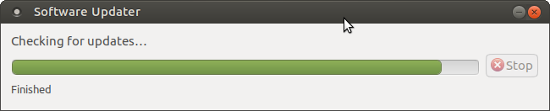
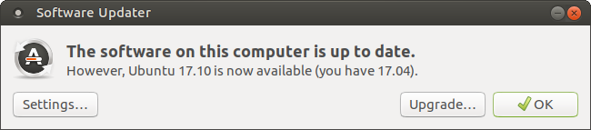
Ubuntu Mate 17.04 to 17.10

Slide 3
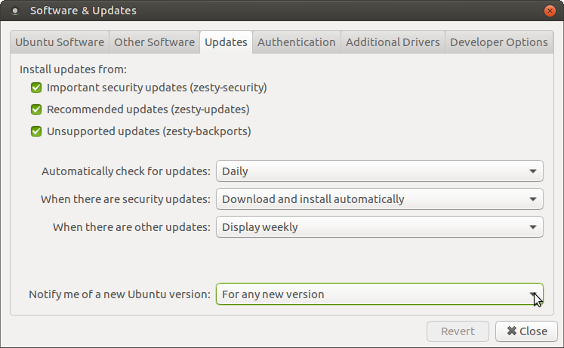
Ubuntu Mate 17.04 to 17.10

Slide 4
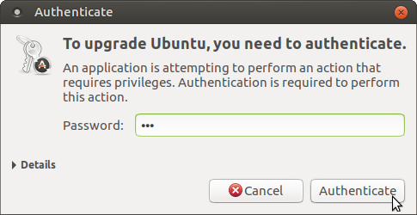
Ubuntu Mate 17.04 to 17.10

Slide 5
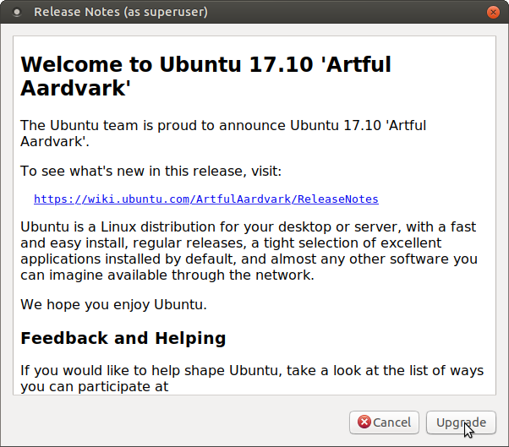
Ubuntu Mate 17.04 to 17.10

Slide 6
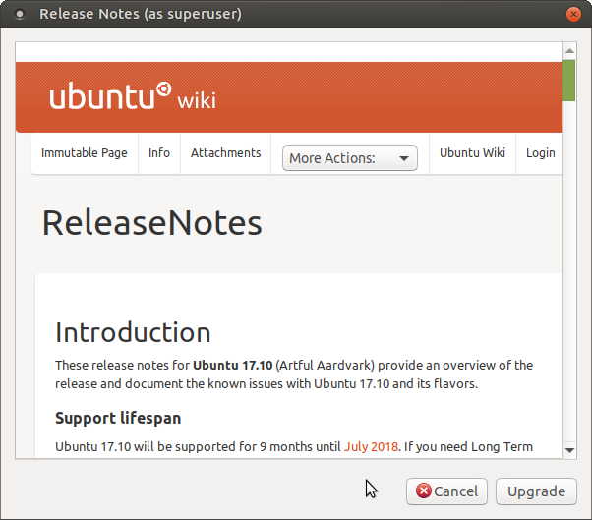
Ubuntu Mate 17.04 to 17.10
Upgrade

Slide 7
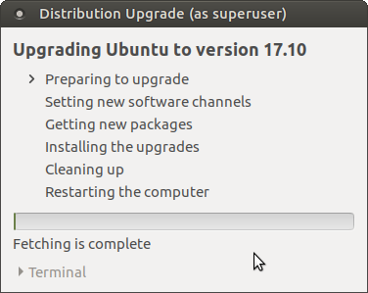
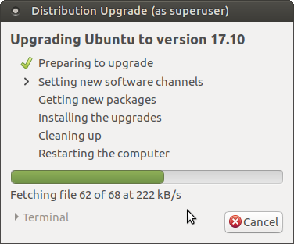
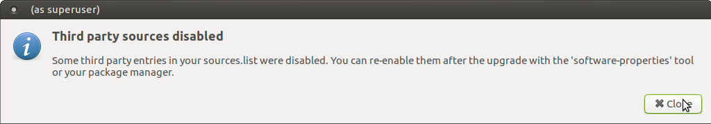
Ubuntu Mate 17.04 to 17.10

Slide 8
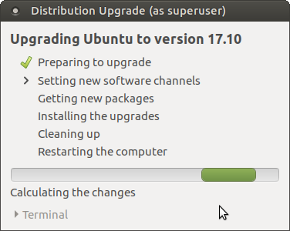
Ubuntu Mate 17.04 to 17.10

Slide 9
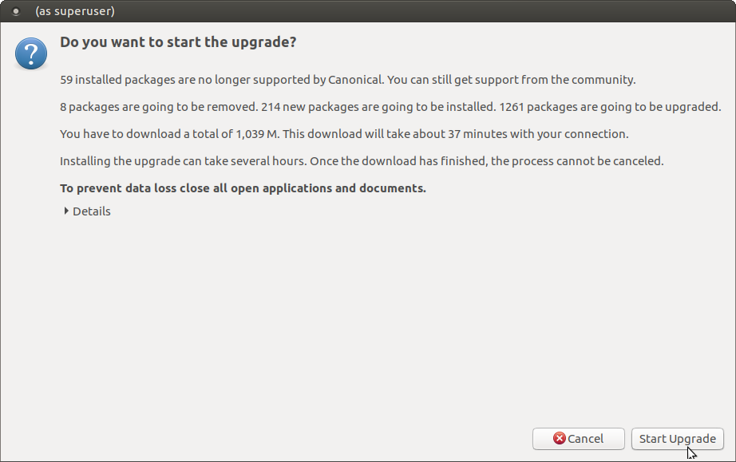
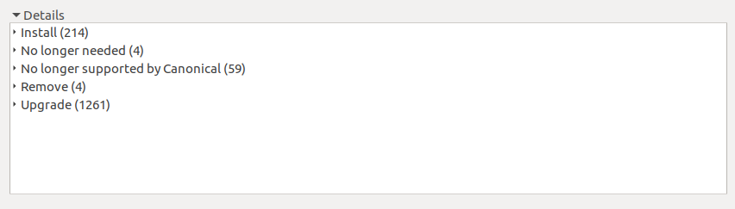
Ubuntu Mate 17.04 to 17.10

Slide 10
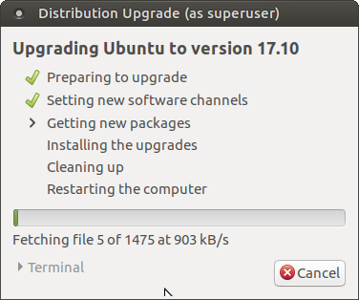
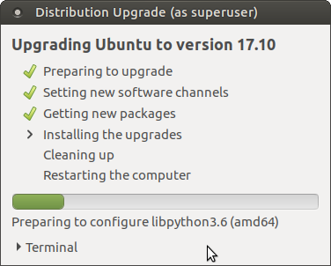
Ubuntu Mate 17.04 to 17.10

Slide 11
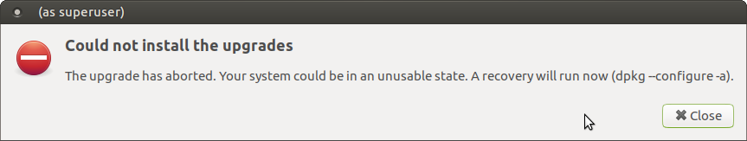
Ubuntu Mate 17.04 to 17.10
Could not install ‘cracklib-runtime’. Dependency problems leaving triggers unprocessed.
ProblemType: Package
Architecture: amd64
Date: Mon Oct 23 12:01:08 2017
Package: cracklib-runtime 2.9.2-5build1
SourcePackage: cracklib2
ErrorMessage:
dependency problems - leaving triggers unprocessed

Slide 12
Ubuntu Mate 17.04 to 17.10
From /var/crash/cracklib-runtime.0.crash
Processing triggers for plymouth-theme-ubuntu-mate-text (17.04.12) ...
update-initramfs: deferring update (trigger activated)
dpkg: dependency problems prevent processing triggers for cracklib-runtime:
cracklib-runtime depends on file; however:
Package file is not configured yet.
dpkg: error processing package cracklib-runtime (--configure):
dependency problems - leaving triggers unprocessed
dpkg: dependency problems prevent processing triggers for cracklib-runtime:
cracklib-runtime depends on file; however:
Package file is not configured yet.
dpkg: error processing package cracklib-runtime (--configure):
dependency problems - leaving triggers unprocessed

Slide 13
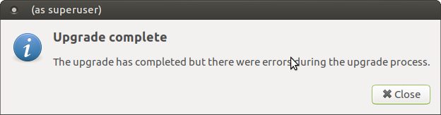
Ubuntu Mate 17.04 to 17.10
Issues:
Could not install ‘cracklib-runtime’. Dependency problems leaving triggers unprocessed.
Used up all RAM unable to take screen-shots.
Failed to clean up at the end.
Took ~2 hours

Slide 14
Ubuntu Mate 17.04 to 17.10
Demo.

